Slide 1


Final Project Financial Institution Network System Design and Implementation
Ahmed, Malek, Mohammed, Rana, Wael, Yasmeen

Slide 2
Agenda
Introduction
Project Goal
Project Technical Tasks
Project Architecture
Task Responsibilities

Slide 3
Introduction
Jubilee Financial Services Ltd (JFSL) is a well-established finance service provider in Kenya,
which offers online finance solutions and services to its clients.
The company operates in the country’s capital city, Nairobi.
It is hosted within an eleven-story building.
The company primarily operates from the seventh to the eighth floors.

Slide 4
Introduction
The company has the following five departments
Human resource (HR).
Customer Service (CS).
Marketing (MK).
Legal Management (LM).
Information Technology (IT).

Slide 5
Introduction
Number of users and other devices per department
Seventh Floor: HR, CS, and MK, each department has at least
40 user devices.
40 IP phones.
one WIFI-AP.
Eighth Floor: LM and IT, each department has at least
20 user devices
20 IP phones,
one WIFI-AP.
each user can have an associated VoIP phone (but not a must).

Slide 6
Introduction
The network infrastructure is currently run and managed by a third-party firm called Infinitive IT Systems Kenya.
The senior management has decided to own its network infrastructure including
Local Area Network (LAN),
Wide Area Network (WAN).
An external Server-Side location
connected via appropriate WAN technology
prioritizing secure communication between the HQ network and the external site.

Slide 7
Company Senior Management Requirement
The server-side site will host DHCP, DNS, WEB, and EMAIL servers.
Company is intending to subscribe to two ISPs (Safaricom and JTL ISPs)
provide redundancy and load-balancing in terms of internet provisions.
The company has also purchased
Two Cisco Catalyst 2911 routers (one for HQ and other for server-side)
One gateway router Catalyst 2811 router (for HQ VoIP)
Two multilayer switches(both for HQ)
Six access switches for the departments

Slide 8
Company Senior Management Requirement
Due to security requirements
All five departments will be on a separate network segment within the same local area network
None of the servers is located within the local area network
It will be hosted from an external site accessible via a WAN connection.
The network security policy will comprehensively dictate the user access to the external site using Access Control LIST (ACL).

Slide 9
Project Goal
We have been hired as Network Security Engineers
Design the network for Jubilee Financial Services Ltd (JFSL)
Due to the requirements set by the senior management
We will consult an appropriate robust network design model to meet the design requirements.
The company will be using the following IP address:
192.168.20.0/24 for Data.
10.10.10.0/24 for Voice.
190.200.100.0 for public addresses.

Slide 10
Project Goal
We will also implement Access Control Lists and Virtual Private Networks to enable secure communication
Considering security and network performance factors paramount to safeguard the Confidentiality, Integrity, and Availability of data and communication.
The company has emphasized
High performance
Redundancy
Scalability
Availability
Hence, we are required to provide a complete JFSL network infrastructure design and implementation.

Slide 11
Project Technical Tasks & Technologies Implemented
1. Creating a network topology using Cisco Packet Tracer.
2. Hierarchical Network Design.
3. Connecting Networking devices with Correct cabling.
4. Configuring Basic device settings.
5. Creating VLANs and assigning ports VLAN numbers.
6. Creating both data and voice VLANs and assigning ports VLAN numbers.

Slide 12
Project Technical Tasks & Technologies Implemented
7. Subnetting and IP Addressing.
8. Configuring Inter-VLAN Routing both on the Switches (SVI) and Routers (router-on-a-stick).
9. Configuring Dedicated DHCP Server device for Data to provide dynamic IP allocation.
10. Configuring Routers as DHCP server for Voice to provide IP Phones dynamic IP allocation.
11. Configuring SSH for secure Remote access.
12. Configuring OSPF as the routing protocol.

Slide 13
Project Technical Tasks & Technologies Implemented
13. Configuring Standard ACL for VTY interfaces to restrict remote Access using SSH.
14. Configuring Port Address Translations or PAT for NAT.
15. Configuring Standard ACL for PAT.
16. Configuring VoIP or Telephony service configuration in all routers.
17. Configuring site-to-site IPsec VPN on the gateway routers.
18. Configuring Standard ACL for site-to-site IPsec VPN.
19. Host Device Configurations.
20. Test and Verifying Network Communication.

Slide 14
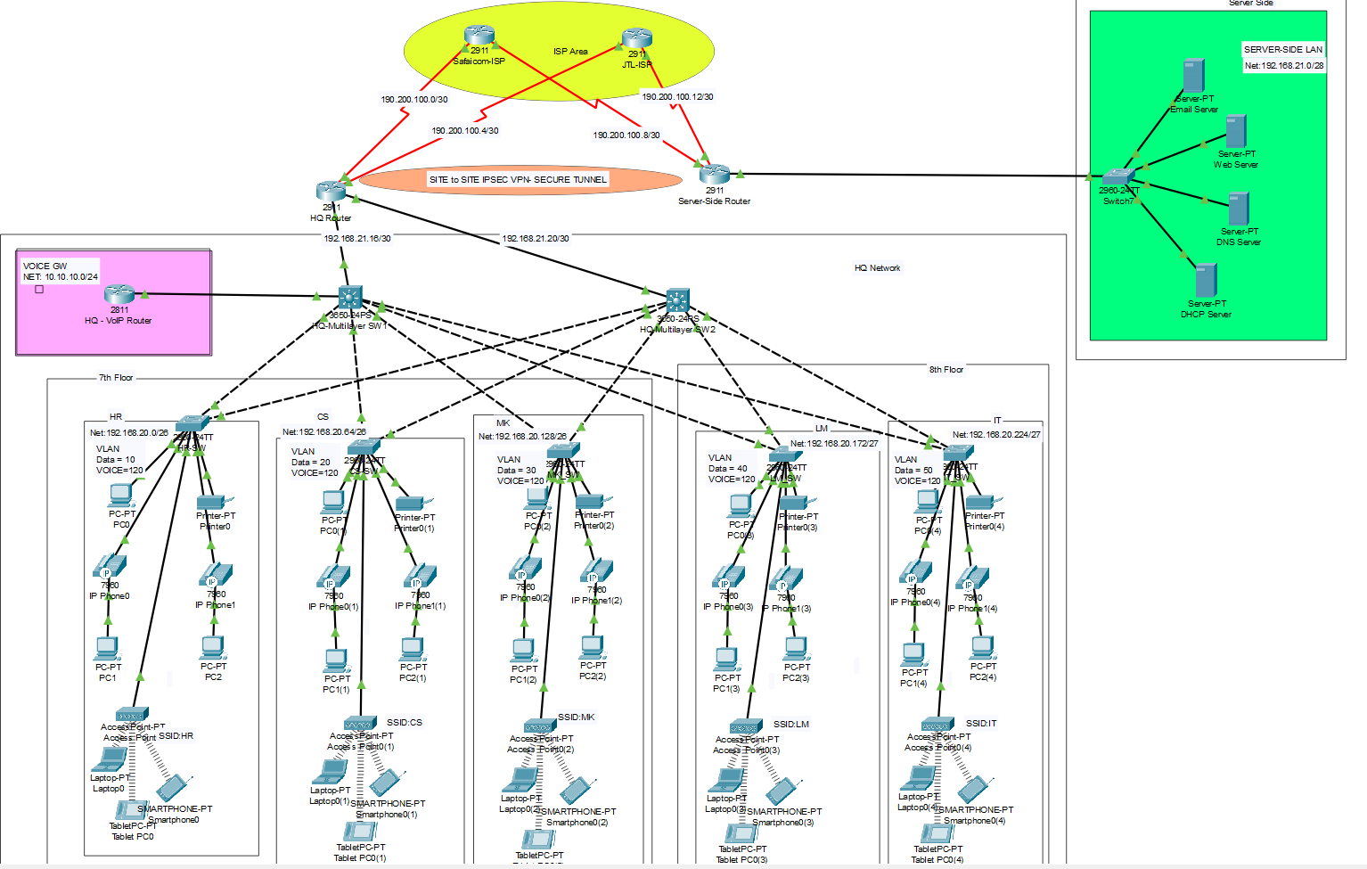
Topology Architecture

Slide 15
Task Responsibility
Mohammed Adel | Network Design and beautification.
Mohammed Adel | Basic settings to all devices plus ssh on the routers and switches.
Mohammed Adel | VLANs(for DATA & VOICE) assignment plus all access and trunk ports on switches.
Wael | Switchport security to server-side site department.
Wael | Subnetting and IP addressing
Wael | OSPF on the routers and 13 switches.
Rana | Standard ACL for SSH
Rana | PAT + Access Control List
Malek | Inter-VLAN routing on the 13 switches plus ip dhcp helper addresses.
Malek | Wireless network configurations.
Malek | Telephony service configuration
Malek | Static IP address to Server-Room devices
Wael | DHCP server device configurations.
Mohammed Adel | Verifying and testing configurations.

Slide 16
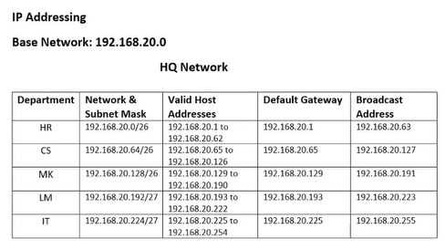
IP Scheme Plan [1]

Slide 17
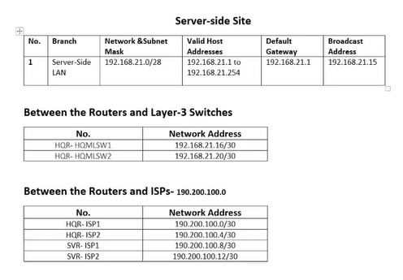
IP Scheme Plan [2]

Slide 18
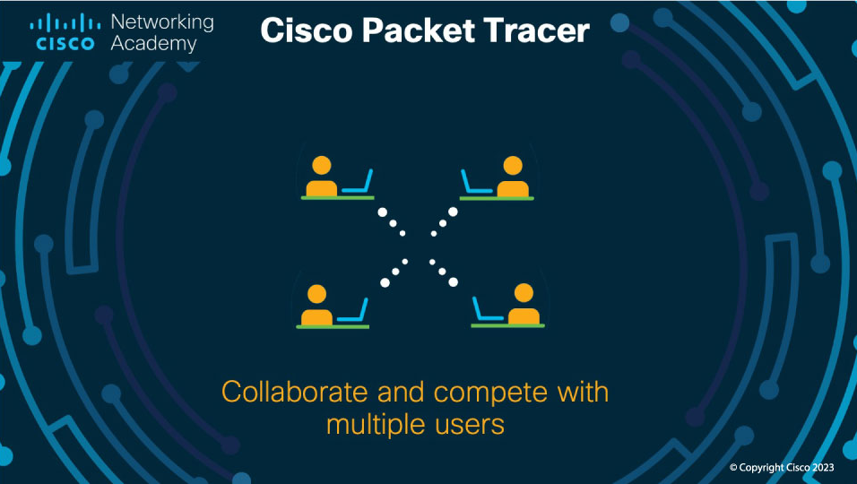
Let’s Go

Slide 19

Thanks for your listening ☺
Questions or Suggestions ?

